Slide 1
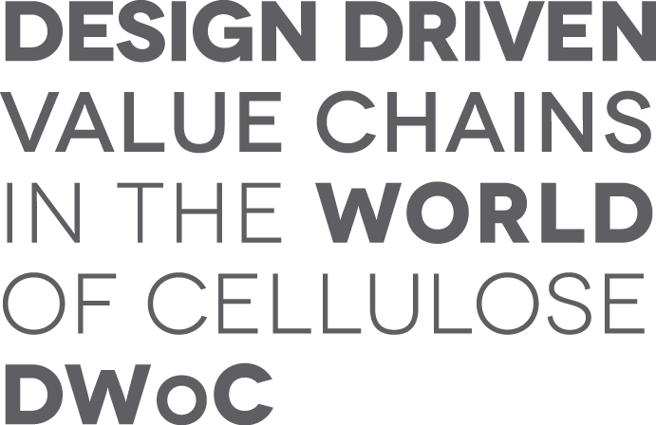
AN INVESTIGATION ON THE DESIGN DRIVEN APPROACH TO MATERIALS DEVELOPMENT
(In DWoC)
KEY ASPECTS FOR COLLABORATION BETWEEN DESIGNERS AND SCIENTISTS IN THE CONTEXT OF MATERIAL DEVELOPMENT
CARLOS PERALTA Ph.D (Cantab)
@ Finlandia Hall, Helsinki, 09/January/2018

Slide 2
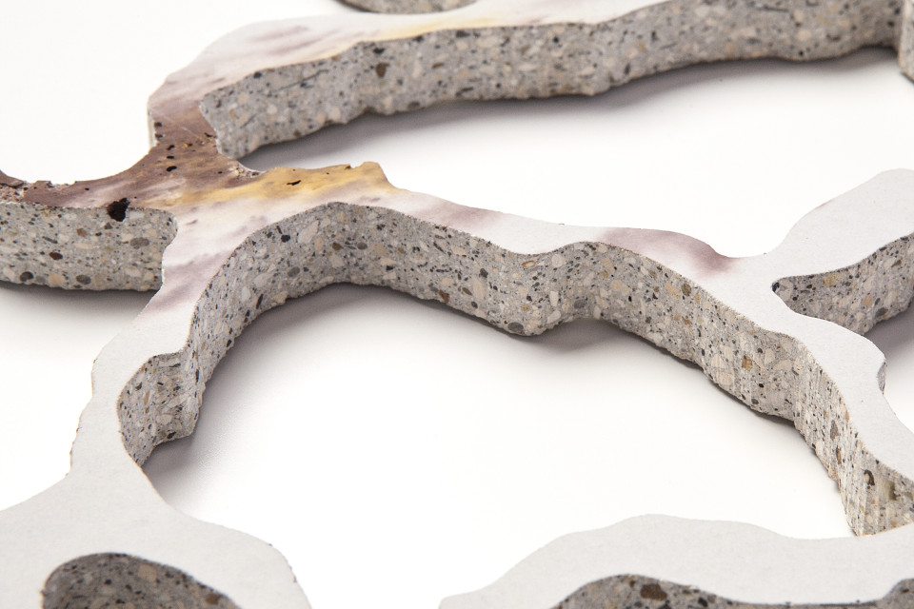
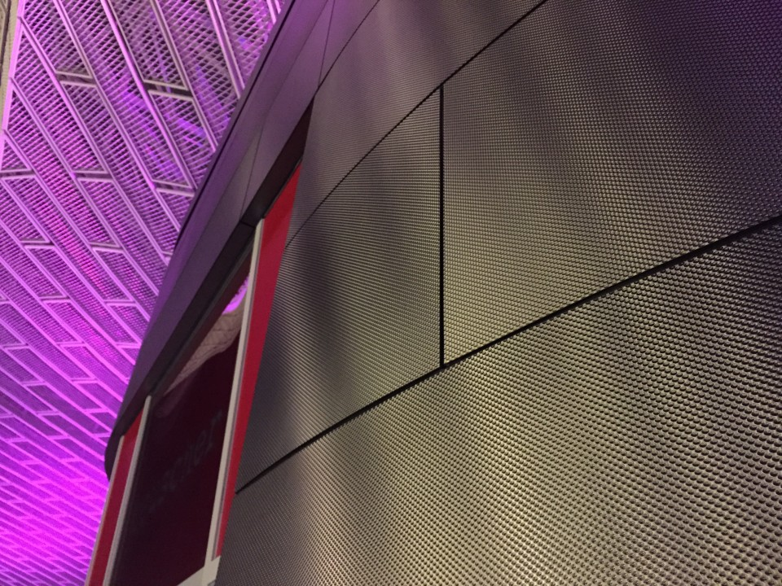
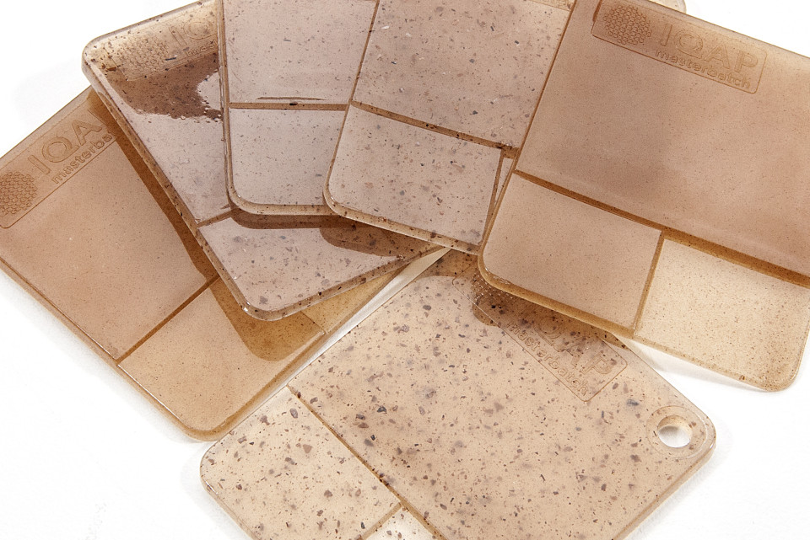
Materials development aims to…
Notes:
-What is material development?
Material development seeks incrasing application
MATERIAL PROPERTIES
STRUCTURE
PERFORMANCE CHARACTERISTICS
MODES OF SYNTHETISING/PRODUCTION
TECHNICAL CHARACTERISTICS EMPHASISES IN RESISTANCE, PERFORMANCE, DURABILITY, HOW THEY WORK AND HOW ARE THEY MADE.
THIS IS IMPORTANT AS MATERIALS ARE THE PRIMARY COMPONENT OF THE OBJECTS WE USE, AND THEREFORE DEFINE SOMEHOW THE WAY WE LIVE.
1 min 30 sec

Slide 3
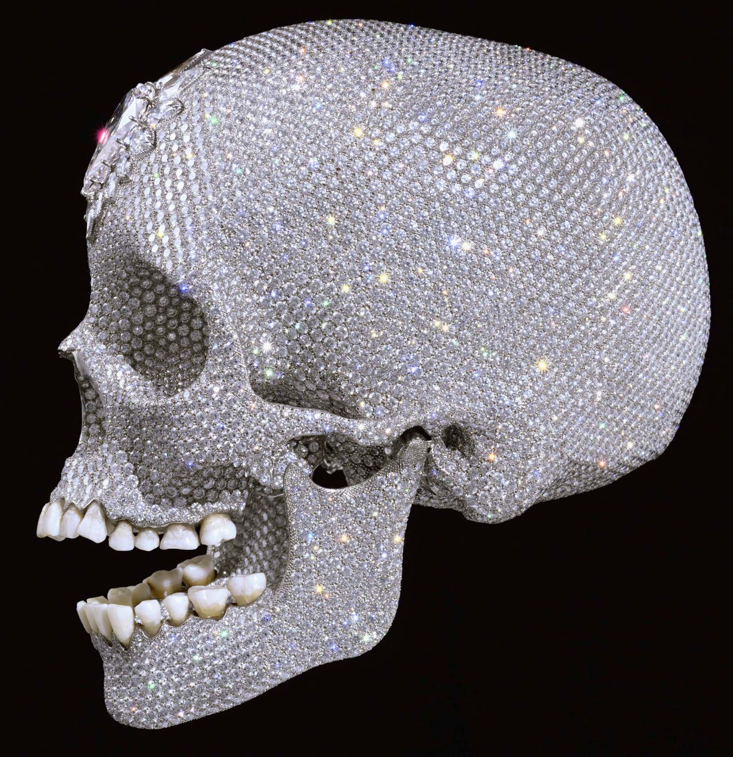
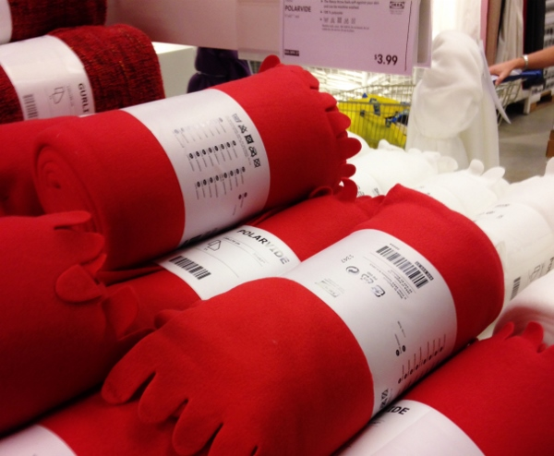
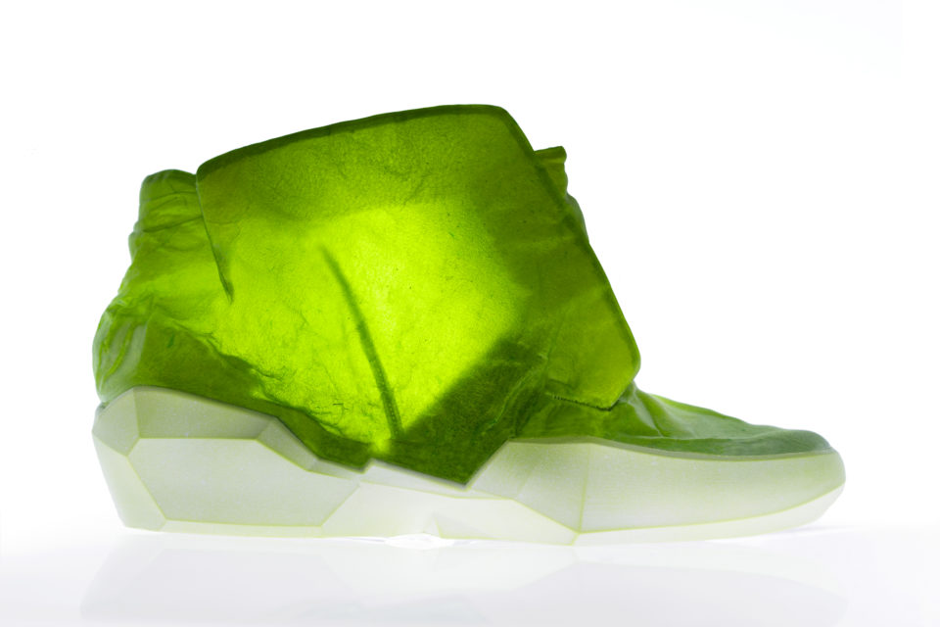
People experience products through their material properties..
Notes:
insufficient as people experience products not only as PERFORMATIVES, PRACTICAL AND FUNCTIONAL ENTITIES, but also as generators of AESTHETIC, SYMBOLIC AND EMOTIONAL EXPERIENCES (Desmet & Hekkert, 2007).
the sensorial characteristics of materials are important, as they are the vehicle by which products “transmit” their aesthetic and symbolic worth: They help to define the experience by which PEOPLE ASSIGN AESTHETIC, EMOTIONAL AND SYMBOLIC VALUE to objects they use, while interacting with them.
THESE PROPERTIES ARE PERCEIVED THROUGH OUR SENSES AND INTERPRETED THROUGH OUR RATIONAL AND PLEASURE CENTRES FOR THAT WE CAN CAL THEM SENSORIAL PROPERTIES
THEY WILL DETERMINE OUR DESIRE TO AQUIRE AND KEEP THESE OBJECTS
1 MIN 30 sec

Slide 4
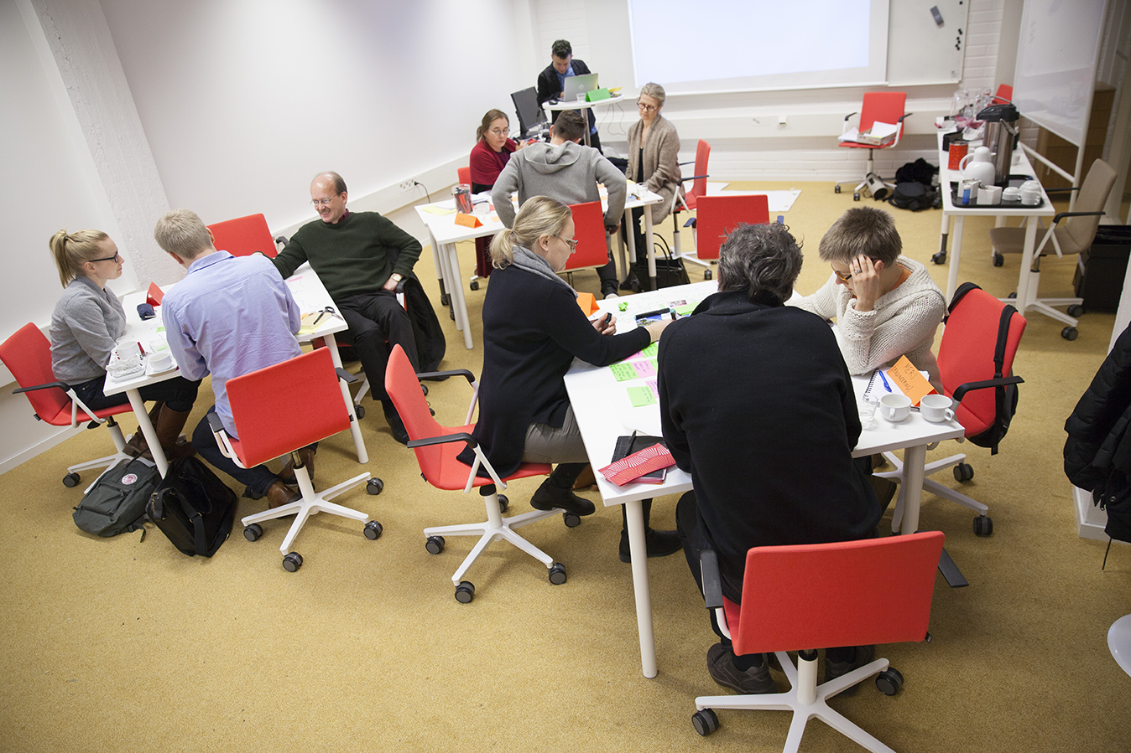
…and having Designers & Scientists collaborating for an integrated development of material properties makes sense
Notes:
In view of this, collaborative work between designers and scientists towards the development of materials appears to be a desirable approach. As DESIGNER’S EXPERTISE RELIES UPON THEIR ABILITY TO TRANSFORM THE MATERIAL WORLD THROUGH THE CREATION OF USEFUL, MEANINGFUL, AND AESTHETICALLY VALUABLE IMAGES, OBJECTS AND SPACES, THEIR ROLE IN EXPLORING MATERIALS PROPERTIES CAN BE COMPLEMENTARY TO THE SCIENTISTS’ ONE. So, while scientists can work towards the development of materials for performance and efficiency, designers do so to enable the creation of “particular experiences for people in particular contexts of use: to define the materials experience” (Karana, Pedgley, & Rognoli, 2014)
Collaborative effort between designers and scientists might help to increase the research potential, as it bring together research methods and approaches from very different disciplinary areas, that can be potentially complementary. Furthermore, it can support a holistic approach to the development of materials, where technical, functional and sensorial characteristics are all developmental drivers. COLLABORATION BETWEEN DESIGNERS AND SCIENTISTS HAS THE POTENTIAL OF GENERATING A WIDER AND RICHER RANGE OF MATERIAL PROPOSITIONS.
1Minute

Slide 5
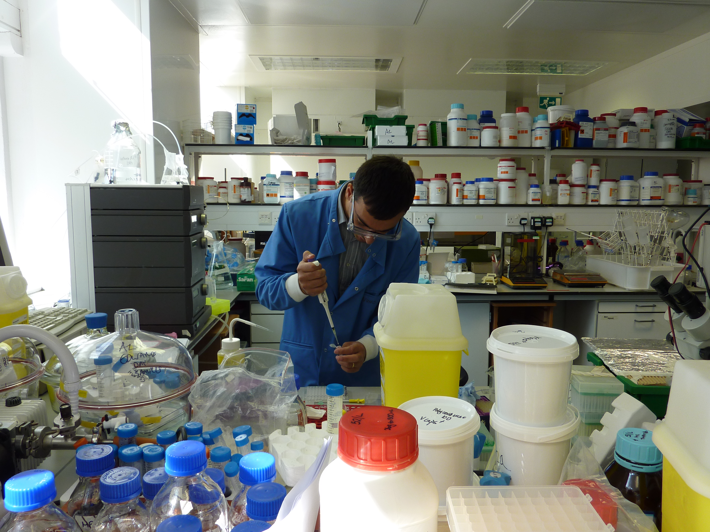
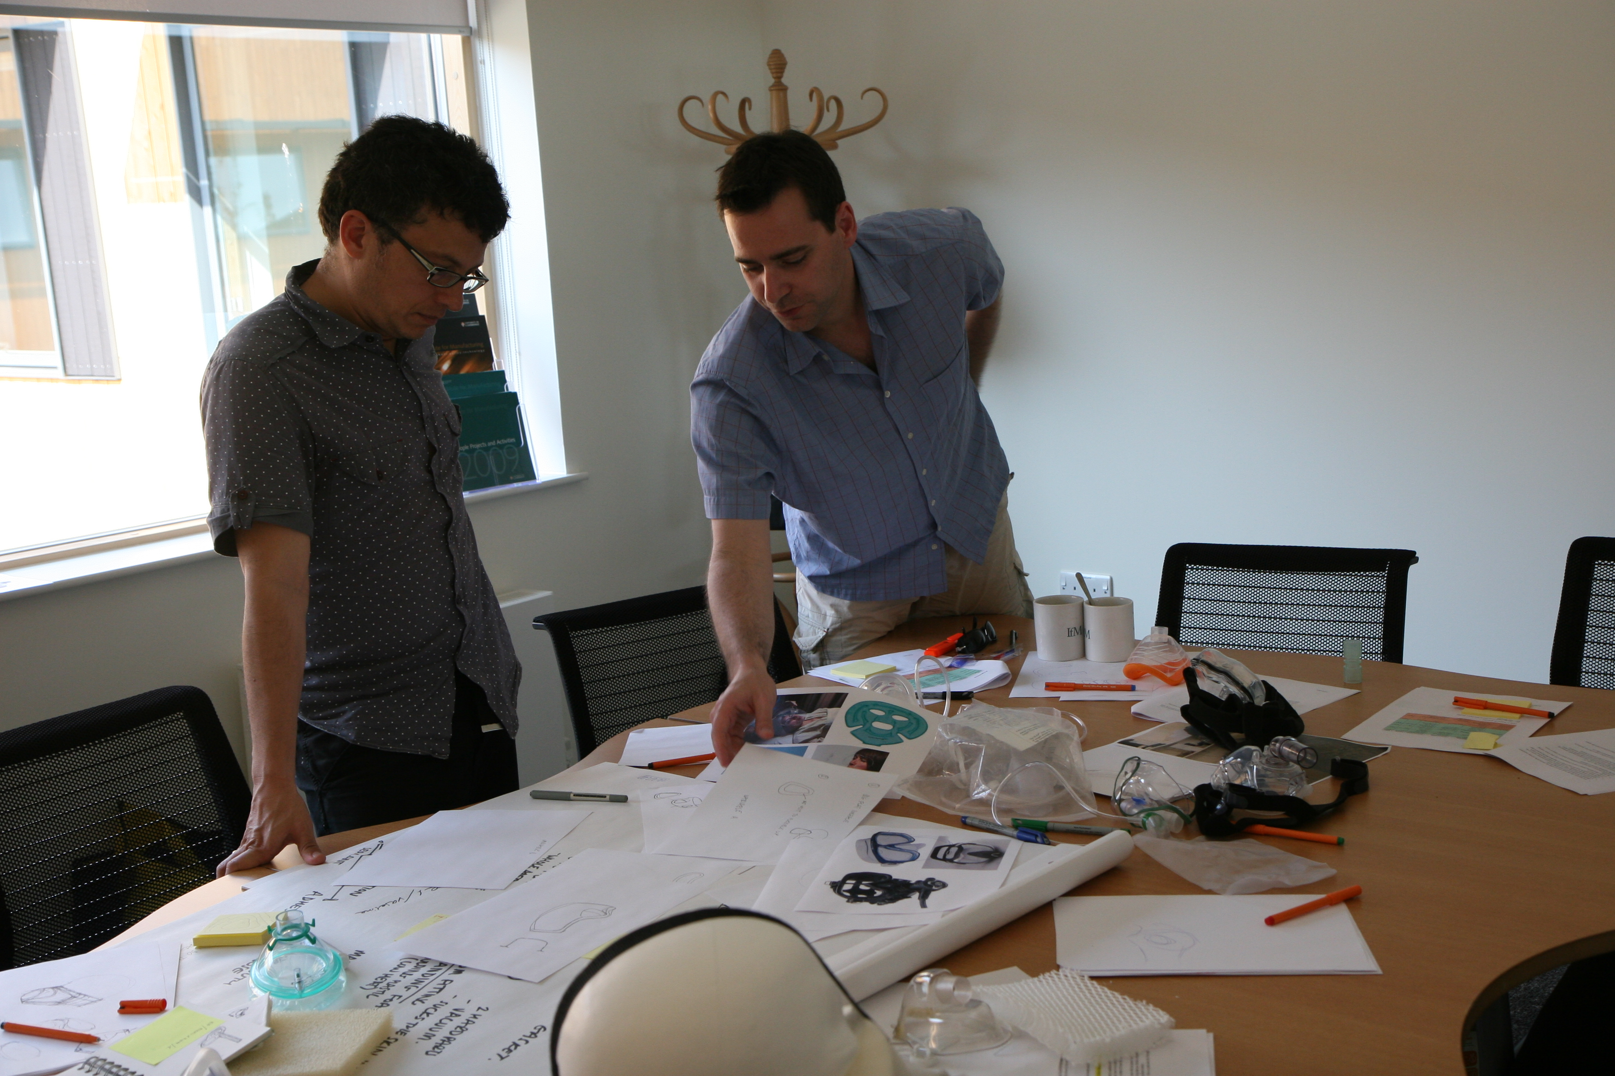
However designers & scientists ARE different and this can be challenging
Notes:
Regardless of how positive collaboration between designers and scientists can be, it can also be challenging as designers and scientists are noticeably different in respect to what:
-THEY KNOW AND WHAT THEIR FIELD OF KNOWLEDGE IS (EPISTEMOLOGICAL DIFFERENCES),
-THEIR OBJECT AND FOCUS OF STUDY IS (ONTOLOGICAL DIFFERENCES)UNDERSTANDING VS TRANSFORMING
-THEIR WORK PROCESSES, PRACTICES AND METHODS ARE (METHODOLOGICAL DIFFERENCES)
Eekels & Roozemburg (1991), Bonsiepe (2007), Krippendorf (2007), Archer (1984), Glanville (1999), Driver et al (2001)
Additionally to disciplinary differences, other factors related for example to the organisations in which the collaboration take place, the working group dynamics, the level of preparedness of individuals for collaboration, or the personal traits of collaborators can undermine (or favour) collaboration Klein (2005), Reich (2006), Spallek (2008).
Studies that report these differences in the context of collaboration are scares
1 MIN 30 sec

Slide 6
KEY ASPECTS to consider in interdisciplinary
collaboration between
DESIGNERS AND SCIENTISTS
IN MATERIALS DEVELOPMENT
Notes:
THIS RESEARCH EXAMINES FOUR CASE STUDIES IN WHICH DESIGNERS AND SCIENTIST COLLABORATED FOR THE DEVELOPMENT OF CELLULOSE-BASED MATERIALS. The case studies took place within the three years research project Design Driven Value Chains in the World of Cellulose (DWoC) funded by TEKES, between 2013 and 2016. The DWoC project involved researchers from Aalto University, Tampere University of Technology, and VTT. It was set up to explore new methods of using cellulose aiming to “make Finland a source of branded value-added cellulosic products and business concepts” DWoC (2015).
EACH CASE STUDY CONSISTS OF A SCIENTIST AND A DESIGNER THAT WORKED TOGETHER AS A RESEARCH TEAM TOWARDS THE DEVELOPMENT OF A CELLULOSE BASED MATERIAL. Through individual structured in-depth interviews, the participant designers and scientists elicited their perceptions about their research process, their role within the team and the barriers to & enablers of collaboration.
The cases for this study correspond to materials development projects within the DWoC project. They were selected following two main conditions. FIRST, THE PROJECT WORKING TEAM NEEDED TO INCLUDE AT LEAST ONE DESIGNER AND ONE SCIENTISTS. Second, their collaboration had to have produced SOME CONCRETE RESEARCH OUTPUT. This particular choice left out of the study researchers that did not engage in interdisciplinary collaboration, or projects that had not produced any output at the time of selection. Two of the cases corresponds to clearly differentiated projects (Case two and case four). The other two cases were part of a wider project that involved all four participants working together, but splitting in subgroups to develop specific aspects of the project. These subgroups corresponds to the cases one and three.
1MINUTE

Slide 7
DIRECT OBSERVATION
SERIES OF INTERDISCIPLINARY WORKSHOPS
INDEPTH INTERVIEWS WITH DWoC DESIGNERS & SCIENTISTS
WHO PARTICIPATED IN FOUR CASE STUDIOS
Notes:
THIS RESEARCH EXAMINES FOUR CASE STUDIES IN WHICH DESIGNERS AND SCIENTIST COLLABORATED FOR THE DEVELOPMENT OF CELLULOSE-BASED MATERIALS. The case studies took place within the three years research project Design Driven Value Chains in the World of Cellulose (DWoC) funded by TEKES, between 2013 and 2016. The DWoC project involved researchers from Aalto University, Tampere University of Technology, and VTT. It was set up to explore new methods of using cellulose aiming to “make Finland a source of branded value-added cellulosic products and business concepts” DWoC (2015).
EACH CASE STUDY CONSISTS OF A SCIENTIST AND A DESIGNER THAT WORKED TOGETHER AS A RESEARCH TEAM TOWARDS THE DEVELOPMENT OF A CELLULOSE BASED MATERIAL. Through individual structured in-depth interviews, the participant designers and scientists elicited their perceptions about their research process, their role within the team and the barriers to & enablers of collaboration.
The cases for this study correspond to materials development projects within the DWoC project. They were selected following two main conditions. FIRST, THE PROJECT WORKING TEAM NEEDED TO INCLUDE AT LEAST ONE DESIGNER AND ONE SCIENTISTS. Second, their collaboration had to have produced SOME CONCRETE RESEARCH OUTPUT. This particular choice left out of the study researchers that did not engage in interdisciplinary collaboration, or projects that had not produced any output at the time of selection. Two of the cases corresponds to clearly differentiated projects (Case two and case four). The other two cases were part of a wider project that involved all four participants working together, but splitting in subgroups to develop specific aspects of the project. These subgroups corresponds to the cases one and three.
1MINUTE

Slide 8
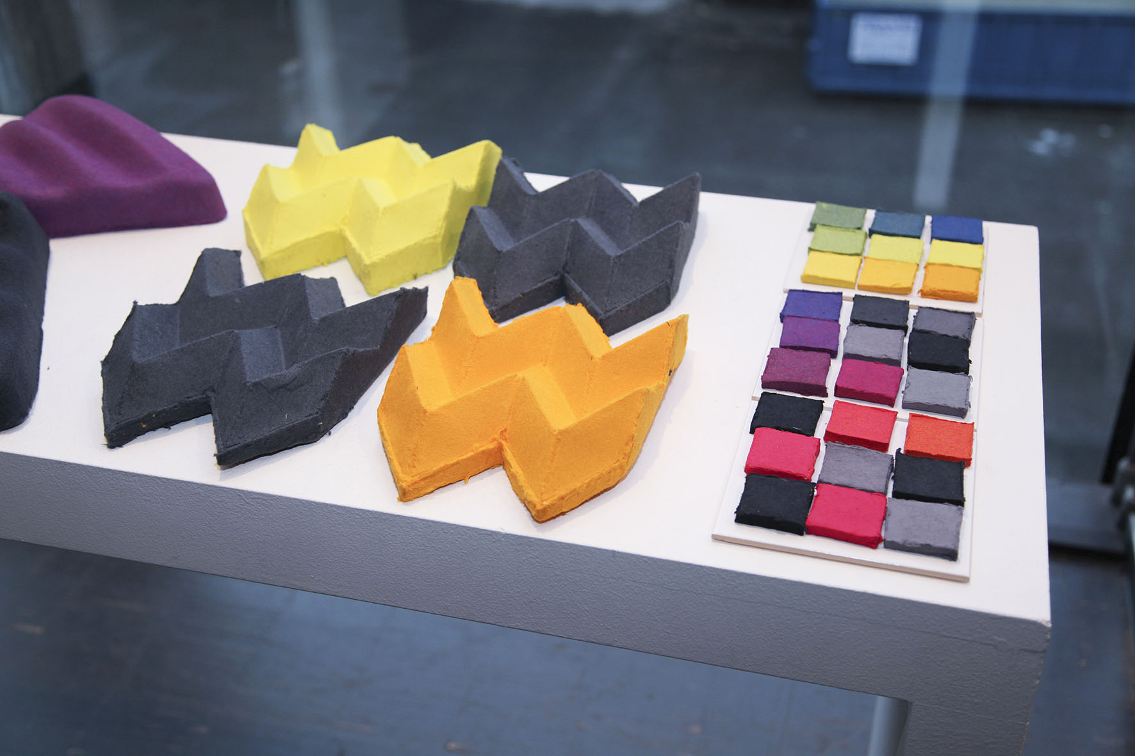
Sustainable design and fibre materials researcher with a background in textile design
The project output:
-3D prototypes
-samples of dyed materials,
-exhibitions and presentations of the work
-journal article
Fibre product researcher with a background in physics and mathematics
Case 1
Foam formed cellulose 3D shaping
Notes:
The team was formed by a fibre product researcher with a background in physics and mathematics and a sustainable design and fibre materials researcher with a background in textile design.
The collaboration was set to develop ways of shaping 3D structures made of foam formed cellulose, and to find potential application for the material.
The project output consisted of 3D prototypes, samples of dyed materials, exhibitions and presentations of the work, and a journal article.
30s

Slide 9
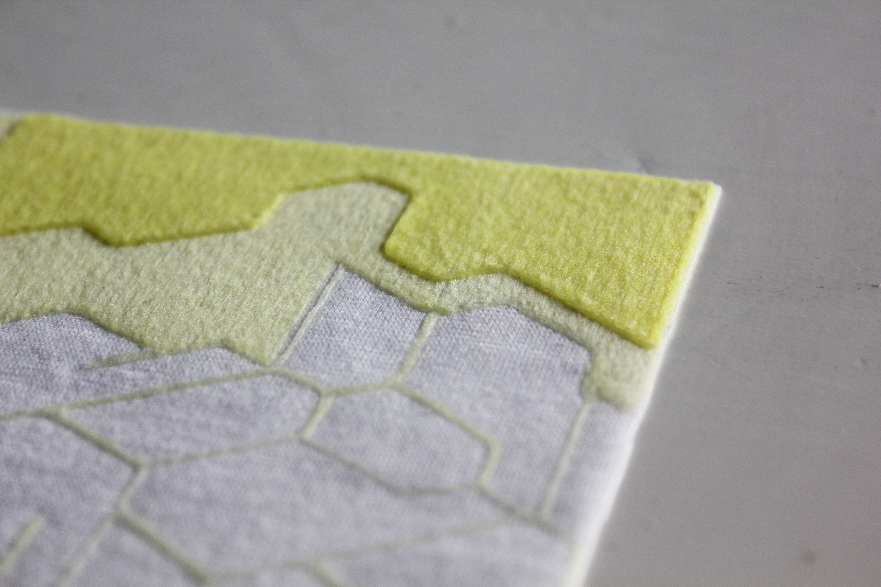
Design researcher with a textile design background (and a physics degree too!)
Researcher in cellulose chemistry with a background in graphic art technology
Picture by Eeva Suorlahti
Project output
-Six demonstrators (showing how the technology could add functionalities to fabrics)
-Poster and an exhibition.
-Designer’s MA thesis.
Case 2
Exploration of functional textiles structures with 3D printing technology
Notes:
The team was formed by a researcher in cellulose chemistry with a background in graphic art technology, and a design researcher with a textile design background (and a physics degree too!).
The collaboration was established to explore future applications of cellulose based 3D printing technology on functional textiles. In addition, to manufacture demonstrators that would communicate the potential of the technology
The project output consisted of six demonstrators (showing how the technology could add functionalities to fabrics), a poster, and an exhibition. The research was also the basis for the designer’s MA thesis.
30s

Slide 10
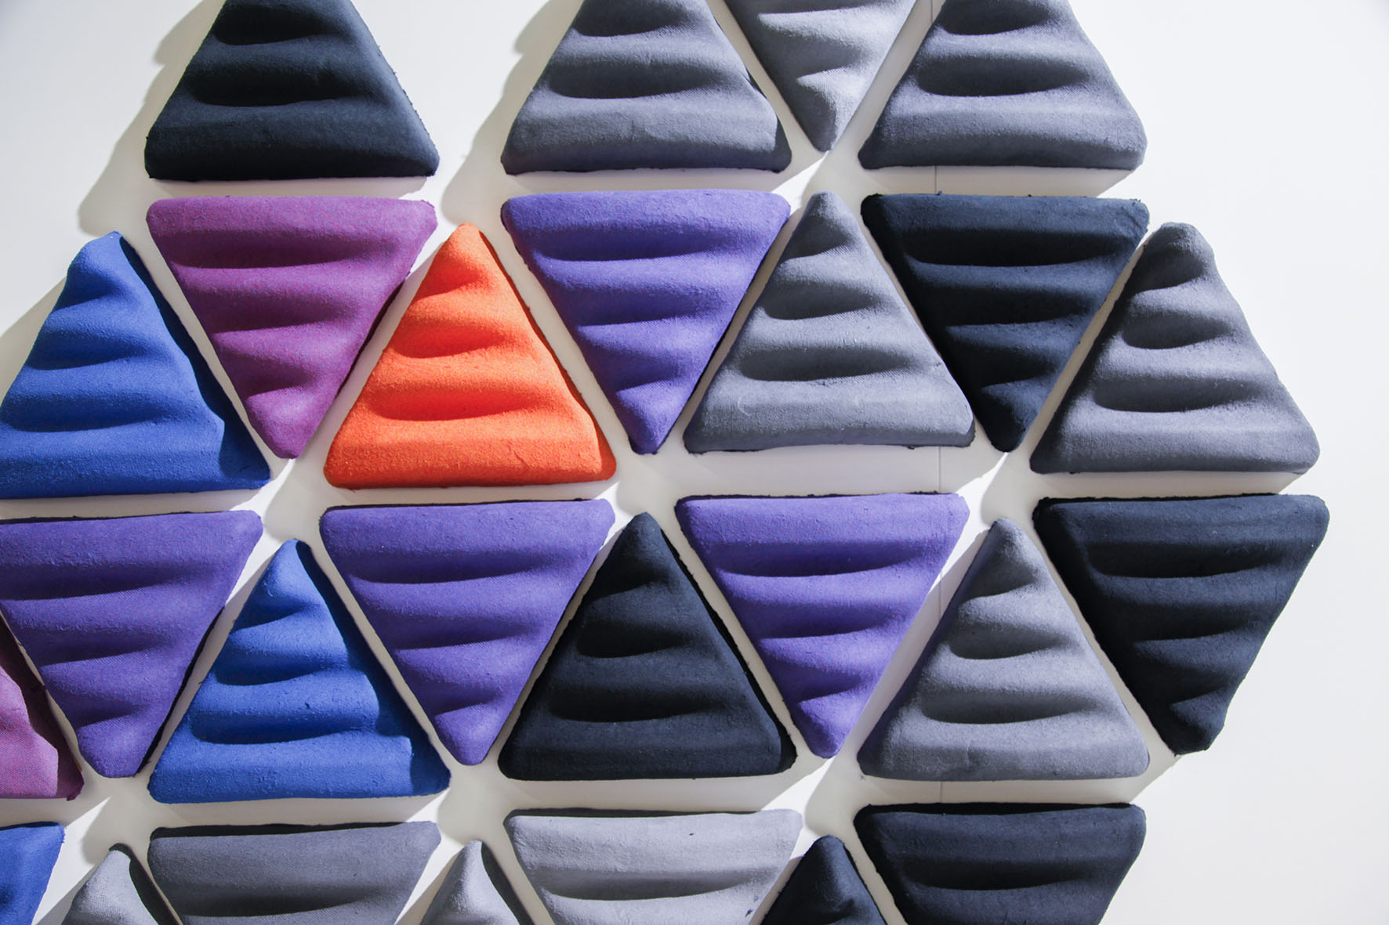
Design researcher with an MA in Industrial and Strategic design
Researcher with a background in Science Engineering and Energy studies
Project output:
-A variety of acoustic interior panels
Several moulds
-An exhibition
-An academic article
Case 3
Moulding development for cellulose foam forming technology
Notes:
A researcher with a background in Science Engineering and Energy studies, and a design researcher with an MA in Industrial and Strategic formed the team.
The collaboration was set to explore applications for foam forming technology and to develop its associated moulding technology. This research ran together with the research undertaken in case 1.
The project output consisted of a variety of acoustic interior panels, several moulds, an exhibition, and an academic article
30s

Slide 11
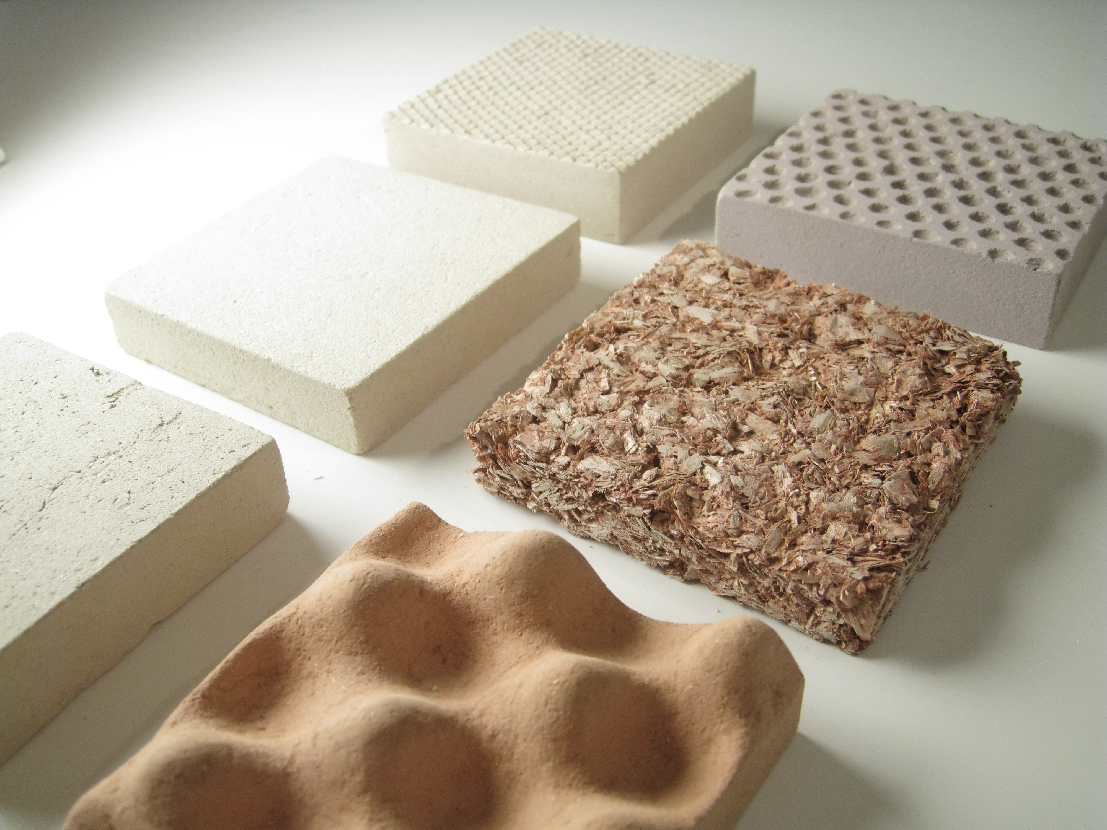
A design researcher with a background in spatial and industrial design as well as in architecture
A researcher with a background in technical technology specialized in papermaking science
Research output:
-A variety of wood-nanocellulose composites
-Curved surfaces with a sprayed film of nanocellulose
-Coloured nanocellulose films.
Case 4
Cellulose application for architectural applications
Notes:
A researcher with a background in technical technology specialised in papermaking science, and a design researcher with a background in spatial and industrial design as well as in architecture formed the team.
The collaboration was set to develop new and future applications of cellulose-based materials in architecture and interior spaces.
The research output consisted of a variety of wood-nanocellulose composites, curved surfaces with a sprayed film of nanocellulose, and coloured nanocellulose films.
30s

Slide 12
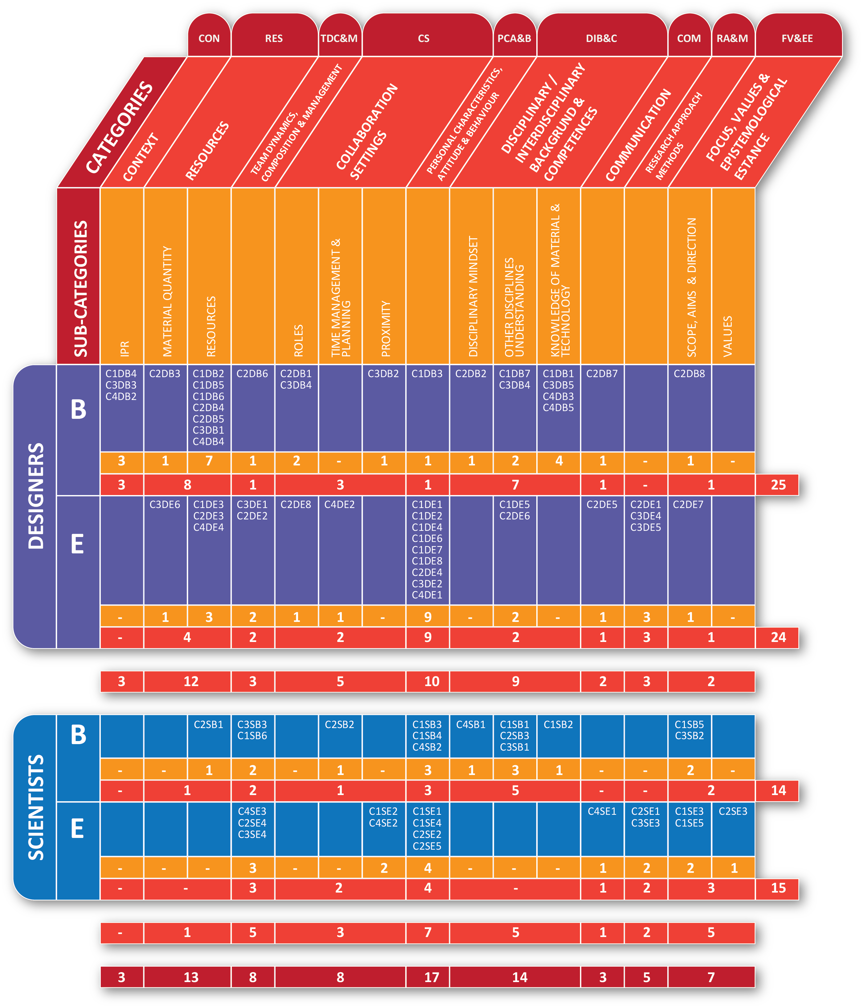
-9 main collaboration categories
-15 collaboration Sub-categories
-78 barriers and enablers
Notes:
15 sec

Slide 13
1 CONTEXT
Refers to the organisational context, legal frameworks in which the research take place. This includes institutional policies, working and organisational culture and practices, etc.
Picture by Eeva Suorlahti
Patenting / IPR / Credit / Involvement / Confidentiality
Notes:
Context: Refers to the organisational context, legal frameworks in which the research take place. This includes institutional policies, working and organisational culture and practices, etc.
Resources: Makes allusion of the availability of physical, human and knowledge resources.
Team dynamics, composition & management: Relates to the way in which research teams works in relation to power, leadership and participation dynamics.
Collaboration settings: Relates to the manner in which research teams are set in relation to working protocols, and in connection to the resources available.
Personal characteristics, attitude & behaviour: Refers to the attitudes and personal traits of collaborators that influences work dynamics.
Disciplinary / interdisciplinary background & competences: Alludes to the disciplinary and interdisciplinary abilities and experience of participants.
Communication: Point out at the ability of collaborators to communicate ideas and to develop a working common vocabulary with fellow team members.
Research approach & methods: Indicates methodological and problem solving approaches, derived or not from disciplinary traditions. Refers to the process stages and to the specific activities that can be performed during the collaboration.
Focus, values and epistemological stance: Relates to disciplinary epistemological assumptions and values.
2minutes

Slide 14
2 TEAM DYNAMICS, COMPOSITION & MANAGEMENT
Relates to the way in which research teams works in relation to power, leadership and participation dynamics.
Picture by Eeva Suorlahti
Team “mileage” / Team Balance / Theoretical & Applied scientists / Managers encouraging people to collaborate
Notes:
Context: Refers to the organisational context, legal frameworks in which the research take place. This includes institutional policies, working and organisational culture and practices, etc.
Resources: Makes allusion of the availability of physical, human and knowledge resources.
Team dynamics, composition & management: Relates to the way in which research teams works in relation to power, leadership and participation dynamics.
Collaboration settings: Relates to the manner in which research teams are set in relation to working protocols, and in connection to the resources available.
Personal characteristics, attitude & behaviour: Refers to the attitudes and personal traits of collaborators that influences work dynamics.
Disciplinary / interdisciplinary background & competences: Alludes to the disciplinary and interdisciplinary abilities and experience of participants.
Communication: Point out at the ability of collaborators to communicate ideas and to develop a working common vocabulary with fellow team members.
Research approach & methods: Indicates methodological and problem solving approaches, derived or not from disciplinary traditions. Refers to the process stages and to the specific activities that can be performed during the collaboration.
Focus, values and epistemological stance: Relates to disciplinary epistemological assumptions and values.
2minutes

Slide 15
3 COLLABORATION SETTINGS
Relates to the manner in which research teams are set in relation to working protocols, and in connection to the resources available.
Picture by Eeva Suorlahti
Physical proximity / role clarity
Notes:
Context: Refers to the organisational context, legal frameworks in which the research take place. This includes institutional policies, working and organisational culture and practices, etc.
Resources: Makes allusion of the availability of physical, human and knowledge resources.
Team dynamics, composition & management: Relates to the way in which research teams works in relation to power, leadership and participation dynamics.
Collaboration settings: Relates to the manner in which research teams are set in relation to working protocols, and in connection to the resources available.
Personal characteristics, attitude & behaviour: Refers to the attitudes and personal traits of collaborators that influences work dynamics.
Disciplinary / interdisciplinary background & competences: Alludes to the disciplinary and interdisciplinary abilities and experience of participants.
Communication: Point out at the ability of collaborators to communicate ideas and to develop a working common vocabulary with fellow team members.
Research approach & methods: Indicates methodological and problem solving approaches, derived or not from disciplinary traditions. Refers to the process stages and to the specific activities that can be performed during the collaboration.
Focus, values and epistemological stance: Relates to disciplinary epistemological assumptions and values.
2minutes

Slide 16
4 PERSONAL CHARACTERISTICS, ATTITUDE & BEHAVIOUR
Refers to the attitudes and personal traits of collaborators that influences work dynamics.
Open mindedness/ Lack of confidence vs boldness when sharing ideas/
Flexibility, willingness to change, enthusiasm, hands on, interest.
Notes:
Context: Refers to the organisational context, legal frameworks in which the research take place. This includes institutional policies, working and organisational culture and practices, etc.
Resources: Makes allusion of the availability of physical, human and knowledge resources.
Team dynamics, composition & management: Relates to the way in which research teams works in relation to power, leadership and participation dynamics.
Collaboration settings: Relates to the manner in which research teams are set in relation to working protocols, and in connection to the resources available.
Personal characteristics, attitude & behaviour: Refers to the attitudes and personal traits of collaborators that influences work dynamics.
Disciplinary / interdisciplinary background & competences: Alludes to the disciplinary and interdisciplinary abilities and experience of participants.
Communication: Point out at the ability of collaborators to communicate ideas and to develop a working common vocabulary with fellow team members.
Research approach & methods: Indicates methodological and problem solving approaches, derived or not from disciplinary traditions. Refers to the process stages and to the specific activities that can be performed during the collaboration.
Focus, values and epistemological stance: Relates to disciplinary epistemological assumptions and values.
2minutes

Slide 17
5 DISCIPLINARY / INTERDISCIPLINARY BACKGROUND & COMPETENCES
Alludes to the disciplinary and interdisciplinary abilities and experience of participants.
Picture by Eeva Suorlahti
Specialised technology knowledge (Designers)/ Preconception about design capability (Scientists)/ Scientists staying within specialty boundaries
Notes:
Context: Refers to the organisational context, legal frameworks in which the research take place. This includes institutional policies, working and organisational culture and practices, etc.
Resources: Makes allusion of the availability of physical, human and knowledge resources.
Team dynamics, composition & management: Relates to the way in which research teams works in relation to power, leadership and participation dynamics.
Collaboration settings: Relates to the manner in which research teams are set in relation to working protocols, and in connection to the resources available.
Personal characteristics, attitude & behaviour: Refers to the attitudes and personal traits of collaborators that influences work dynamics.
Disciplinary / interdisciplinary background & competences: Alludes to the disciplinary and interdisciplinary abilities and experience of participants.
Communication: Point out at the ability of collaborators to communicate ideas and to develop a working common vocabulary with fellow team members.
Research approach & methods: Indicates methodological and problem solving approaches, derived or not from disciplinary traditions. Refers to the process stages and to the specific activities that can be performed during the collaboration.
Focus, values and epistemological stance: Relates to disciplinary epistemological assumptions and values.
2minutes

Slide 18
6 RESOURCES
Makes allusion of the availability of physical, human and knowledge resources.
Picture by Eeva Suorlahti
Materials quantities / Raw material production vs. Material sampling
Notes:
Context: Refers to the organisational context, legal frameworks in which the research take place. This includes institutional policies, working and organisational culture and practices, etc.
Resources: Makes allusion of the availability of physical, human and knowledge resources.
Team dynamics, composition & management: Relates to the way in which research teams works in relation to power, leadership and participation dynamics.
Collaboration settings: Relates to the manner in which research teams are set in relation to working protocols, and in connection to the resources available.
Personal characteristics, attitude & behaviour: Refers to the attitudes and personal traits of collaborators that influences work dynamics.
Disciplinary / interdisciplinary background & competences: Alludes to the disciplinary and interdisciplinary abilities and experience of participants.
Communication: Point out at the ability of collaborators to communicate ideas and to develop a working common vocabulary with fellow team members.
Research approach & methods: Indicates methodological and problem solving approaches, derived or not from disciplinary traditions. Refers to the process stages and to the specific activities that can be performed during the collaboration.
Focus, values and epistemological stance: Relates to disciplinary epistemological assumptions and values.
2minutes

Slide 19
7 RESEARCH APPROACH & METHODS
Indicates methodological and problem solving approaches, derived or not from disciplinary traditions. Refers to the process stages and to the specific activities that can be performed during the collaboration.
Picture by Eeva Suorlahti
Joint feedback and ideation sessions/ joint prototyping/ “thinking and doing together”/ designers learning scientists’ tools/
Notes:
Context: Refers to the organisational context, legal frameworks in which the research take place. This includes institutional policies, working and organisational culture and practices, etc.
Resources: Makes allusion of the availability of physical, human and knowledge resources.
Team dynamics, composition & management: Relates to the way in which research teams works in relation to power, leadership and participation dynamics.
Collaboration settings: Relates to the manner in which research teams are set in relation to working protocols, and in connection to the resources available.
Personal characteristics, attitude & behaviour: Refers to the attitudes and personal traits of collaborators that influences work dynamics.
Disciplinary / interdisciplinary background & competences: Alludes to the disciplinary and interdisciplinary abilities and experience of participants.
Communication: Point out at the ability of collaborators to communicate ideas and to develop a working common vocabulary with fellow team members.
Research approach & methods: Indicates methodological and problem solving approaches, derived or not from disciplinary traditions. Refers to the process stages and to the specific activities that can be performed during the collaboration.
Focus, values and epistemological stance: Relates to disciplinary epistemological assumptions and values.
2minutes

Slide 20
8 FOCUS, VALUES AND EPISTEMOLOGICAL STANCE
Relates to disciplinary epistemological assumptions and values.
Picture by Eeva Suorlahti
Timing-emphasis/ target clarity/ shared understanding of project goal & target/
Design driven approach
Notes:
Context: Refers to the organisational context, legal frameworks in which the research take place. This includes institutional policies, working and organisational culture and practices, etc.
Resources: Makes allusion of the availability of physical, human and knowledge resources.
Team dynamics, composition & management: Relates to the way in which research teams works in relation to power, leadership and participation dynamics.
Collaboration settings: Relates to the manner in which research teams are set in relation to working protocols, and in connection to the resources available.
Personal characteristics, attitude & behaviour: Refers to the attitudes and personal traits of collaborators that influences work dynamics.
Disciplinary / interdisciplinary background & competences: Alludes to the disciplinary and interdisciplinary abilities and experience of participants.
Communication: Point out at the ability of collaborators to communicate ideas and to develop a working common vocabulary with fellow team members.
Research approach & methods: Indicates methodological and problem solving approaches, derived or not from disciplinary traditions. Refers to the process stages and to the specific activities that can be performed during the collaboration.
Focus, values and epistemological stance: Relates to disciplinary epistemological assumptions and values.
2minutes

Slide 21
Collaboration between designers and scientists:
=
Picture by Eeva Suorlahti
MEANINGFUL, USEFUL, BEAUTIFUL , TECHNICALLY OPTIMAL AND VALUABLE MATERIALS.
Notes:
ENOUGH MATERIAL TO PLAY AND EXPLORE
The meaning of material changes material is not someting to look at, to disect, to create…it is something to make things out of it, to transform and to shape. WORK BASED ON A GOOD UNDERSTANDING OF EACHOTHER CAPABILITIES
Designers is not about aesthetics, or product making, is about process, discovery and experimenting AND GETtiNG YOUR HANDS DIRtY WITh thE MATERIAL
Communicating through making, to material and gaining the shared knowledge,
Appreciating the strong bound that working with your hands and creating together give you.
2 MINUTES

Slide 22
THANKS!
CARLOS PERALTA Ph.D (Cantab)
@ Finlandia Hall, Helsinki, 09/January/2018

